Slide 1
_{Chapter 3}
_{Data and Signals}

Slide 2

Note
To be transmitted, data must be transformed to electromagnetic signals.

Slide 3
3-1 ANALOG AND DIGITAL
Data can be analog or digital. The term analog data refers to information that is continuous; digital data refers to information that has discrete states. Analog data take on continuous values. Digital data take on discrete values.
Topics discussed in this section:
Analog and Digital Data Analog and Digital Signals Periodic and Nonperiodic Signals

Slide 4
Note
Data can be analog or digital. Analog data are continuous and take continuous values.
Digital data have discrete states and take discrete values.

Slide 5
Note
Signals can be analog or digital. Analog signals can have an infinite number of values in a range; digital signals can have only a limited number of values.

Slide 6
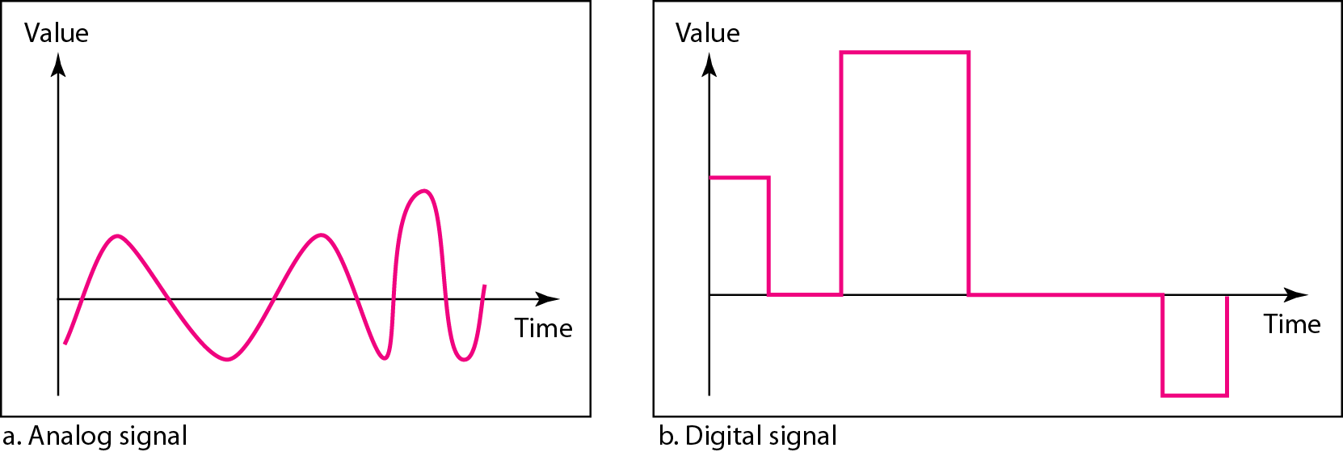
Figure 3.1 Comparison of analog and digital signals [1]

Slide 7
Note
In data communications, we commonly use periodic analog signals and nonperiodic digital signals.

Slide 8
3-2 PERIODIC ANALOG SIGNALS
Periodic analog signals can be classified as simple or composite. A simple periodic analog signal, a sine wave, cannot be decomposed into simpler signals. A composite periodic analog signal is composed of multiple sine waves.

Slide 9
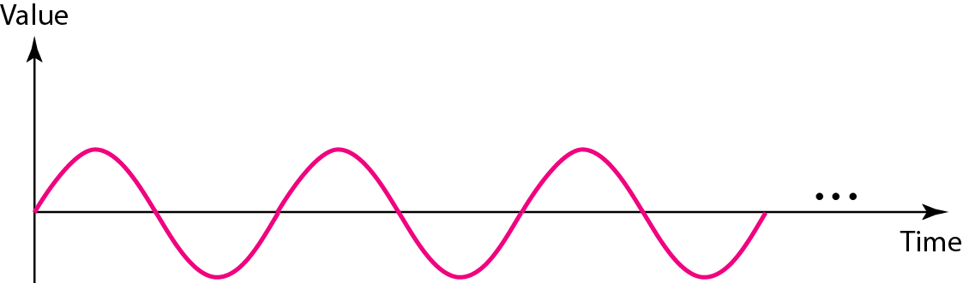
Figure 3.2 A sine wave [1]
_{s(t ) = A sin(2πft + φ)}
_{A-Amplitude}
_{2π = 360 degree =1Period}
_{φ --Phase}

Slide 10
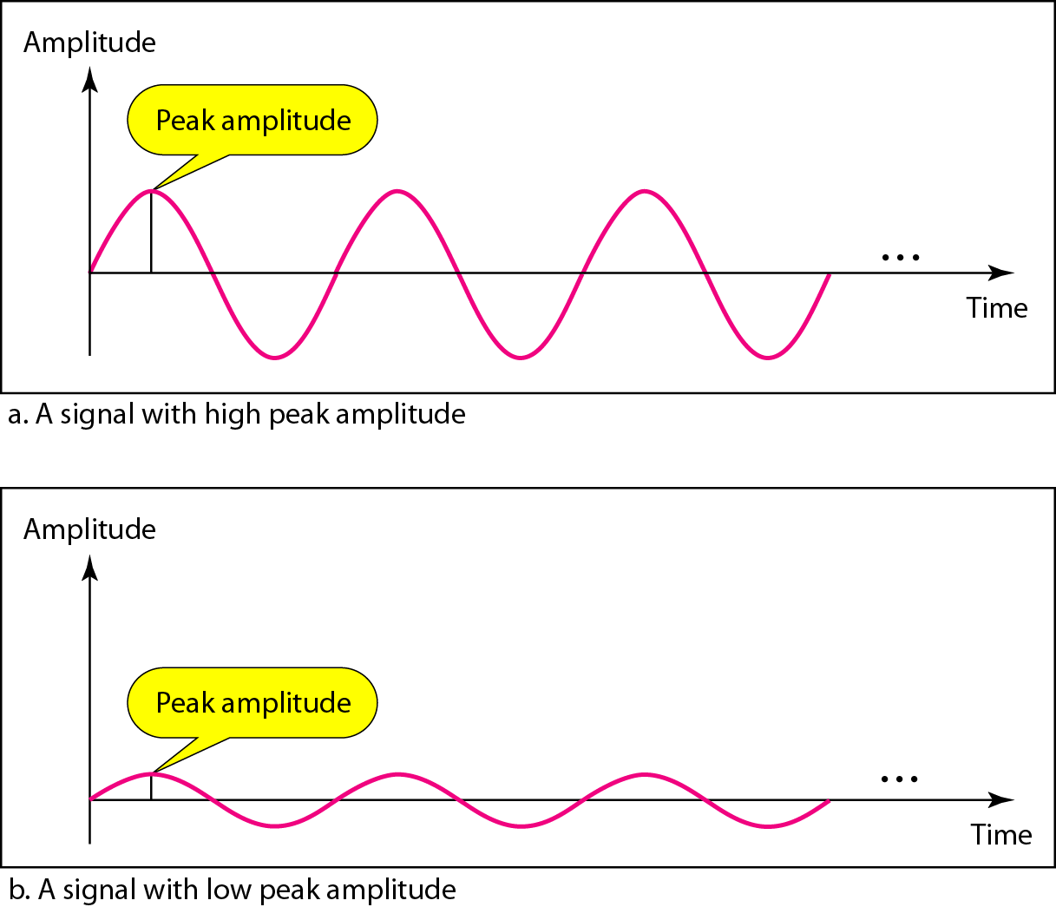
Figure 3.3 Two signals with the same phase and frequency, but different amplitudes [1]

Slide 11

Note
Frequency and period are the inverse of each other.

Slide 12
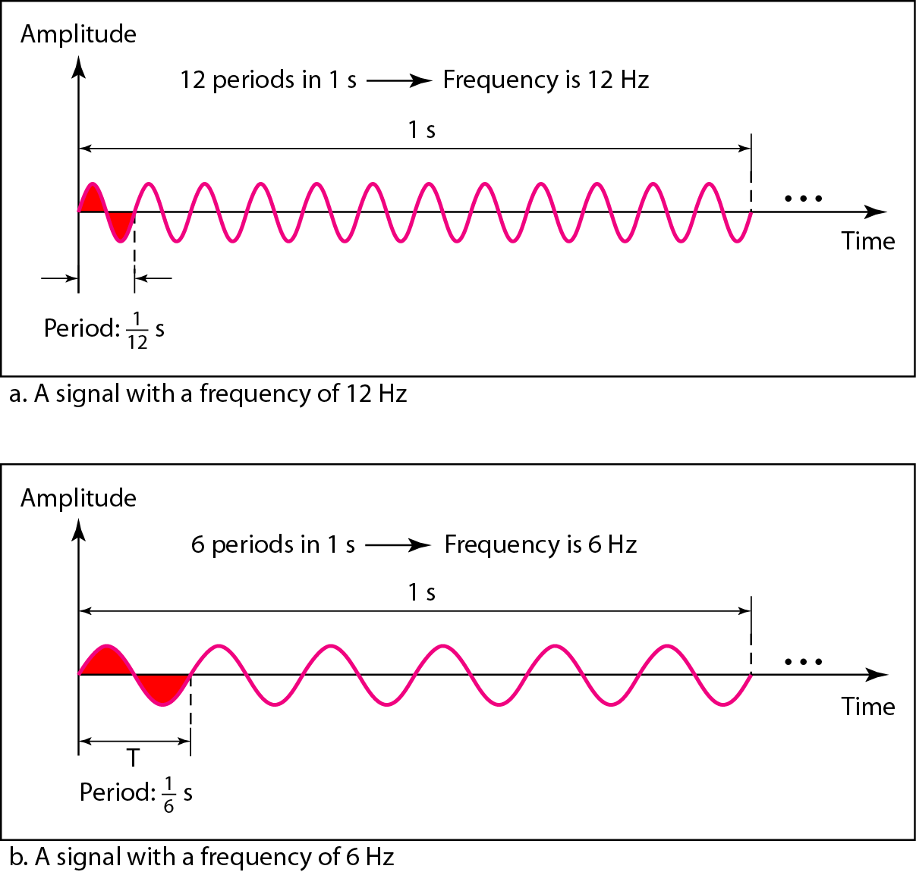
Figure 3.4 Two signals with the same amplitude and phase, but different frequencies [1]

Slide 13
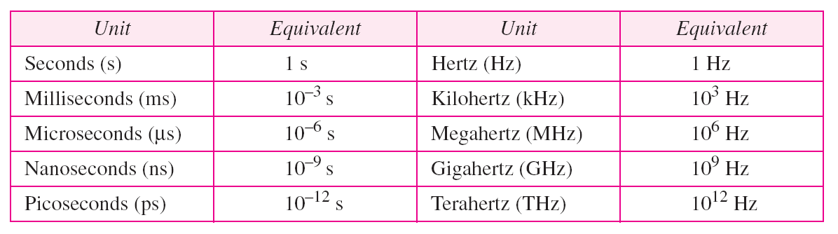
Table 3.1 Units of period and frequency [1]

Slide 14
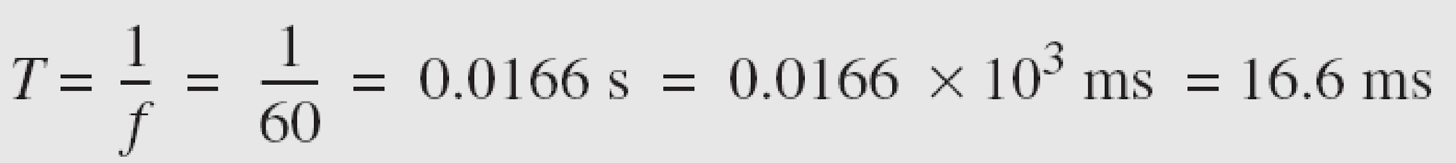
Example 3.3
The power we use at home has a frequency of 60 Hz. The period of this sine wave can be determined as follows:

Slide 15
Example 3.4
Express a period of 100 ms in microseconds.
Solution
From Table 3.1 we find the equivalents of 1 ms (1 ms is 10⁻³ s) and 1 s (1 s is 10⁶ μs). We make the following substitutions:.

Slide 16
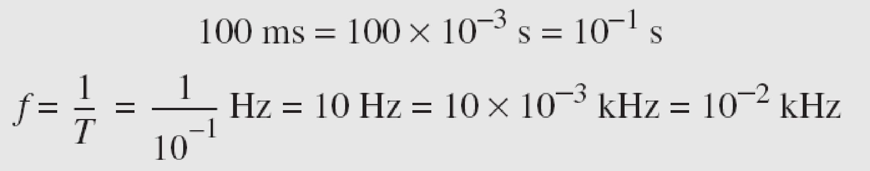
Example 3.5
The period of a signal is 100 ms. What is its frequency in kilohertz?
Solution
First we change 100 ms to seconds, and then we calculate the frequency from the period (1 Hz = 10⁻³ kHz).

Slide 17
Note
Frequency is the rate of change with respect to time. Change in a short span of time
means high frequency. Change over a long span of time means low frequency.

Slide 18
Note
If a signal does not change at all, its frequency is zero.
If a signal changes instantaneously, its frequency is infinite.

Slide 19
Note
Phase describes the position of the waveform relative to time 0.

Slide 20
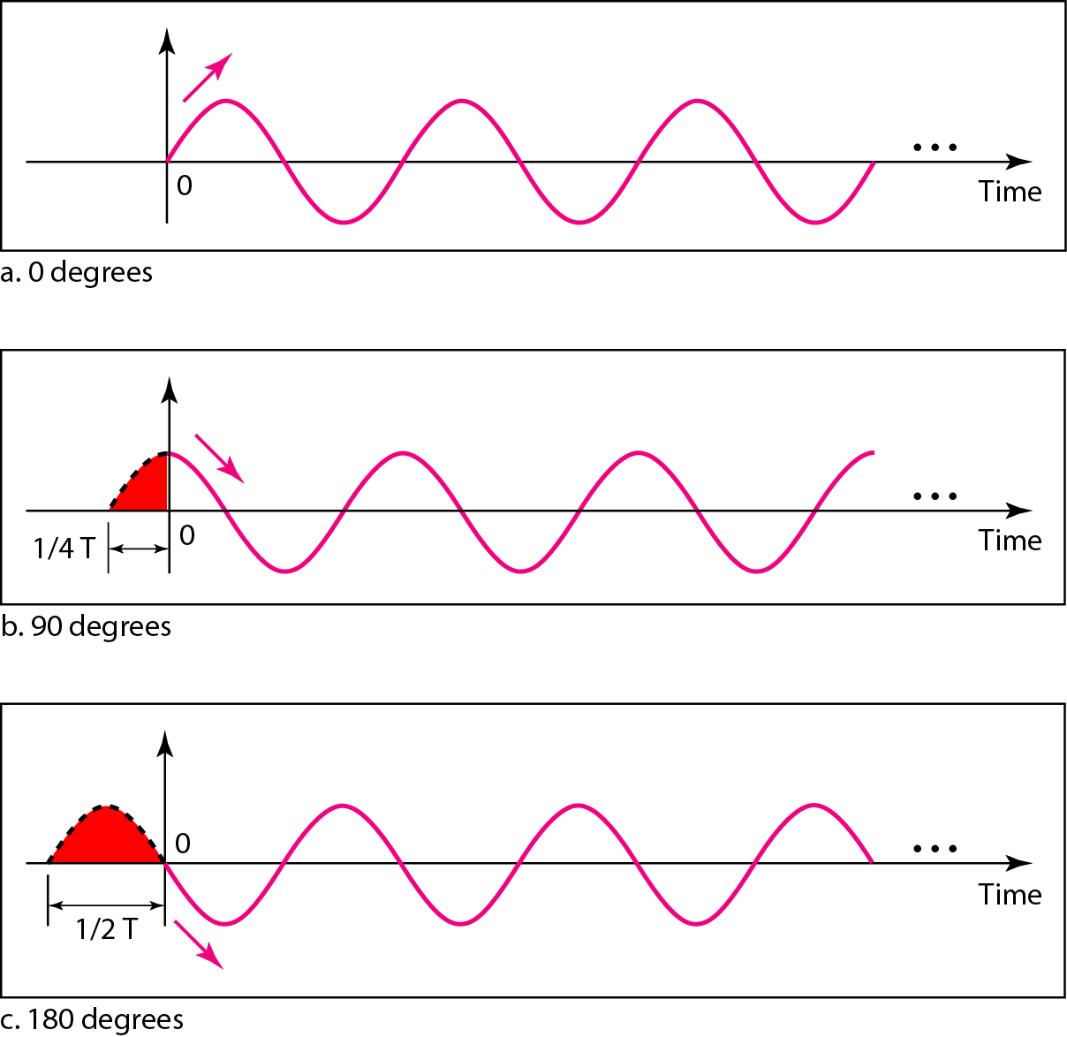
Figure 3.5 Three sine waves with the same amplitude and frequency, but different phases [1]

Slide 21
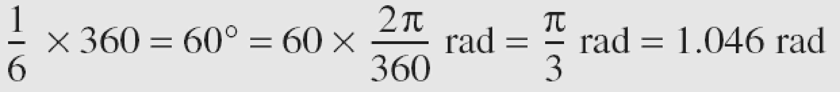
Example 3.6
A sine wave is offset 1/6 cycle with respect to time 0. What is its phase in degrees and radians?
Solution
We know that 1 complete cycle is 360°. Therefore, 1/6 cycle is

Slide 22
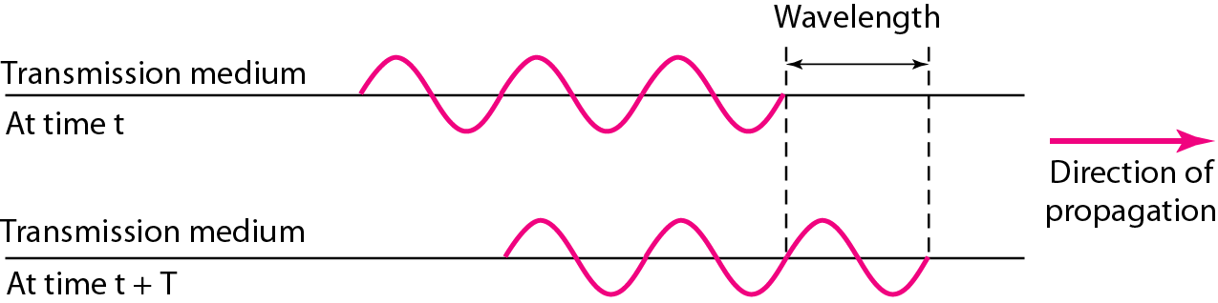
Figure 3.6 Wavelength and period [1]
The wavelength is the distance a simple signal can travel in one period.

Slide 23
Note
A complete sine wave in the time domain can be represented by one single spike in the frequency domain.

Slide 24
Note
The bandwidth of a composite signal is the difference between the
highest and the lowest frequencies contained in that signal.

Slide 25

Example 3.10
If a periodic signal is decomposed into five sine waves with frequencies of 100, 300, 500, 700, and 900 Hz, what is its bandwidth?
Solution
Let f_{h} be the highest frequency, f_{l} the lowest frequency, and B the bandwidth. Then

Slide 26
A very important consideration in data communications is how fast we can send data, in bits per second, over a channel.
Data rate depends on three factors:
1. The bandwidth available
2. The level of the signals we use
3. The quality of the channel (the level of noise)
3-5 DATA RATE LIMITS
Topics discussed in this section:
Noiseless Channel: Nyquist Bit Rate Noisy Channel: Shannon Capacity Using Both Limits

Slide 27
Noiseless Channel: Nyquist Bit Rate
For a noiseless channel, the Nyquist bit rate formula defines the theoretical maximum bit rate
BitRate = 2 x bandwidth x log₂ M
L-Levels for sending signals

Slide 28
Given a bandwidth of B, the highest signal transmission rate is 2B:
C = 2B
eg: B=3100 Hz; C=6200 bps
With multilevel signaling
C = 2B log₂ M,
where M is the number of discrete signal or voltage levels

Slide 29
Note
Increasing the levels of a signal may reduce the reliability of the system.

Slide 30
Example 3.34
Consider a noiseless channel with a bandwidth of 3000 Hz transmitting a signal with two signal levels. The maximum bit rate can be calculated as

Slide 31
Example 3.35
Consider the same noiseless channel transmitting a signal with four signal levels (for each level, we send 2 bits). The maximum bit rate can be calculated as

Slide 32
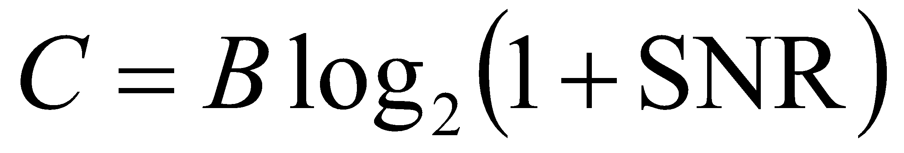
Noisy Channel: Shannon Capacity
In 1944,Claude Shannon introduced a formula, called the Shannon capacity, to determine the
theoretical highest data rate for a noisy channel:
Signal-to-noise ratio (SNR) = power of signal/power of noise
A high SNR means a high-quality signal.

Slide 33
Note
The Shannon capacity gives us the upper limit; the Nyquist formula tells us how many signal levels we need.

Slide 34
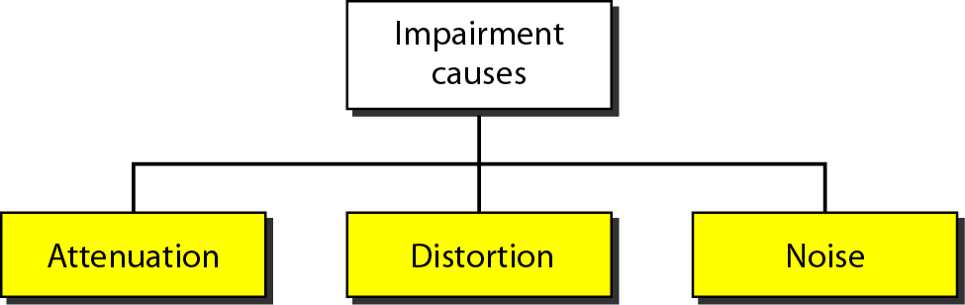
3-4 TRANSMISSION IMPAIRMENT
Signals travel through transmission media, which are not perfect.
The imperfection causes signal impairment.
This means that the signal at the beginning of the medium is not the same as the signal at the end of the medium.
What is sent is not what is received.
Three causes of impairment are attenuation, distortion, and noise.

Slide 35
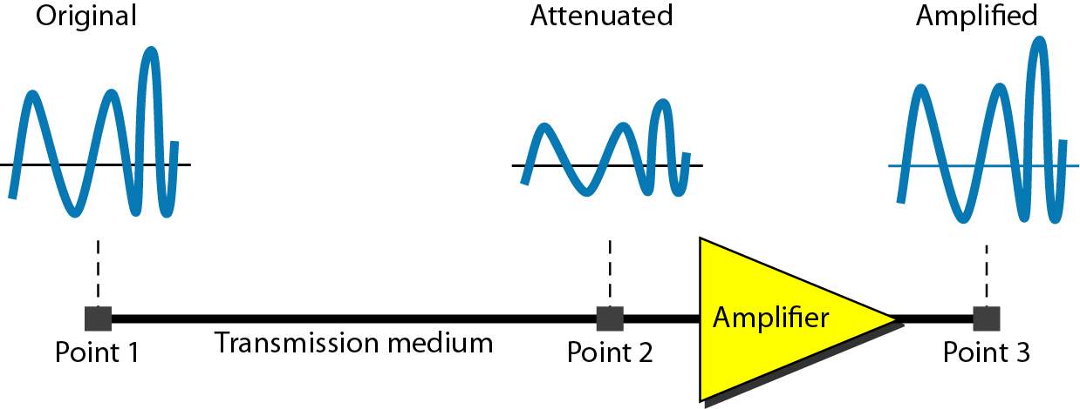
_{Attenuation}
Attenuation means a loss of energy.
it loses some of its energy in overcoming the resistance of the medium.
To compensate for this loss, amplifiers are used to amplify the signal.
_{Figure:} _{Attenuation [1]}

Slide 36

The decibel(dB) measures the relative strengths of two signals or one signal at two different points.

Slide 37

_{Example}
Suppose a signal travels through a transmission medium and its power is reduced to one-half.
_{P2= (1/2)P1.}
In this case, the attenuation (loss of power) can be calculated as
A loss of 3 dB (–3 dB) is equivalent to losing one-half the power.

Slide 38

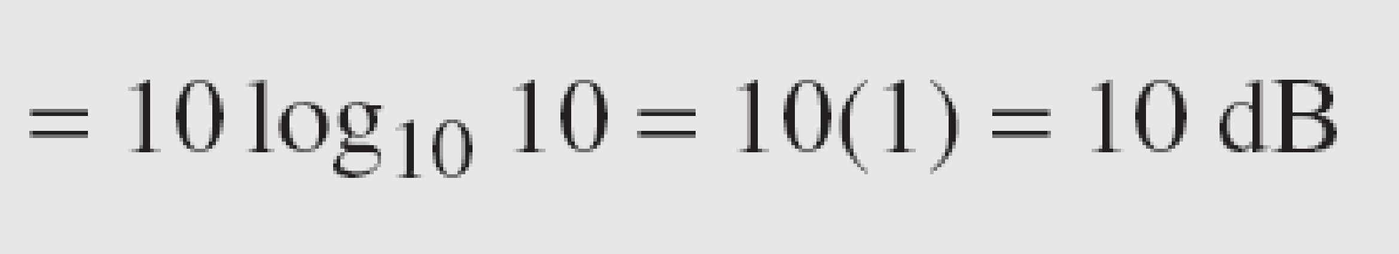
_{Example}
A signal travels through an amplifier, and its power is increased 10 times.
_{This means that P2 = 10P1 .}
What is the amplification (gain of power)?
₃₈

Slide 39
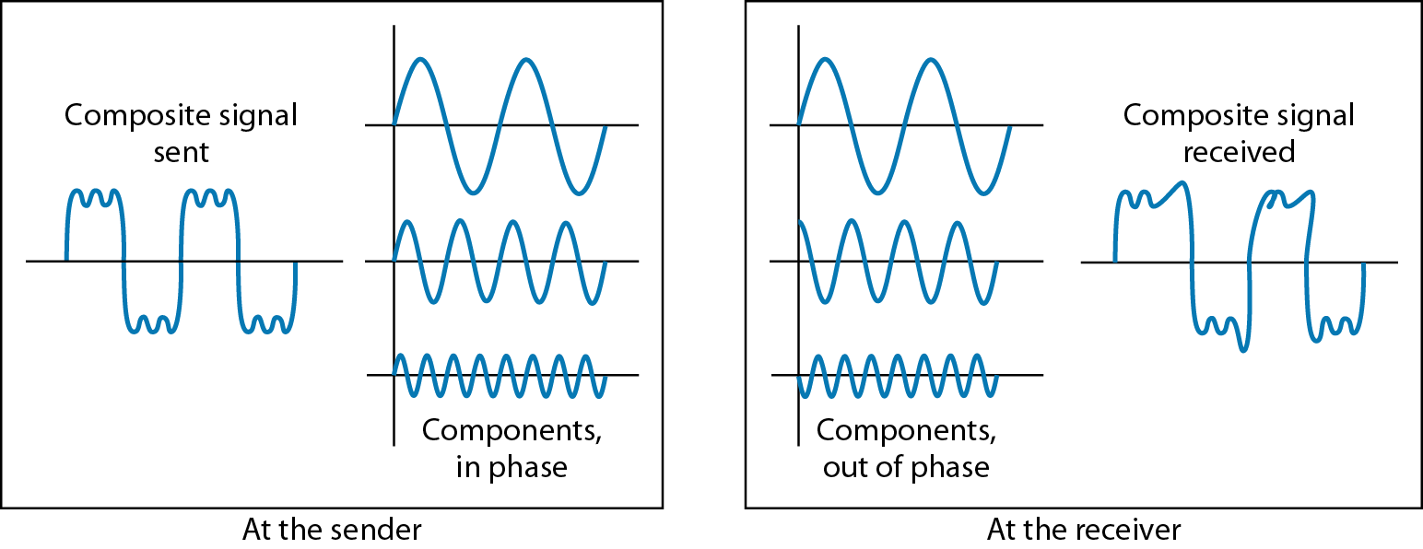
_{Distortion}
Distortion means that the signal changes its form or shape.
_{Figure: Distortion [1]}

Slide 40
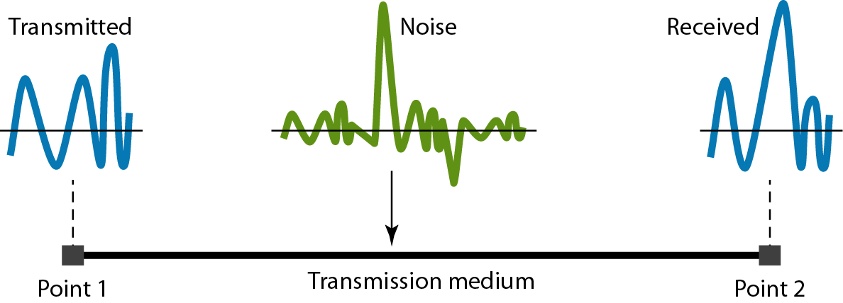
_{Noise}
Several types of noise, such as thermal noise,
induced noise, crosstalk, and impulse noise, may corrupt the signal.
_{Figure:} _{Noise [1]}

Slide 41
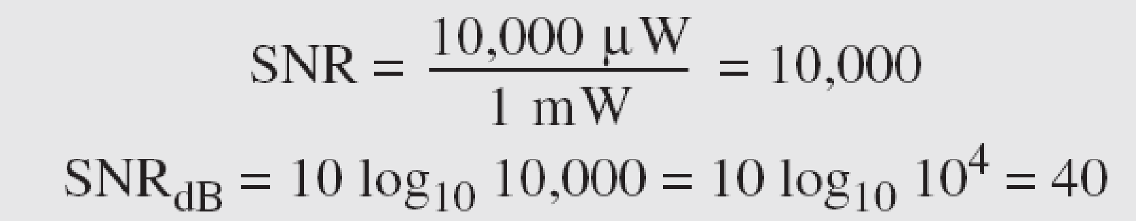
_{Example}
The power of a signal is 10 mW and the power of the noise is 1 μW; what are the values of SNR and SNRdB ?
_{Solution}
The values of SNR and SNRdB can be calculated as follows:
₄₁

Slide 42
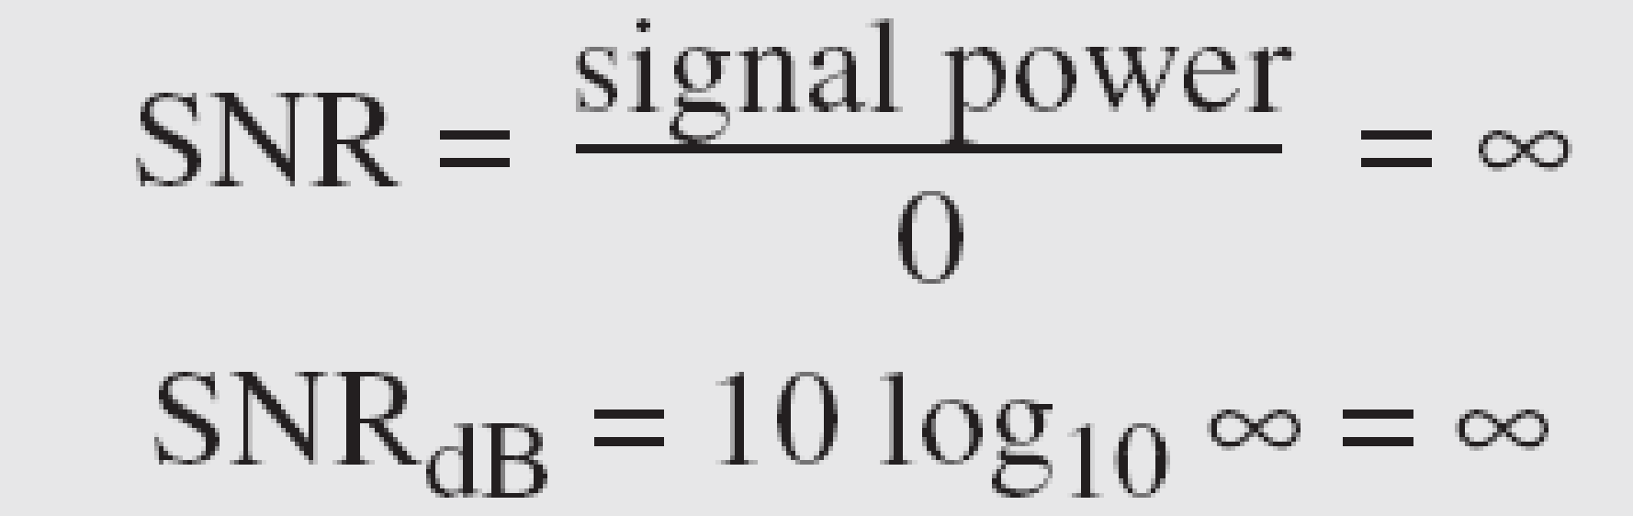
_{Example}
The values of SNR and SNRdB for a noiseless channel are
We can never achieve this ratio in real life; it is an ideal.
₄₂

Slide 43
References:
Textbooks
[1] Forouzan, Behrouz A.: “Data Communications & networking”, 4th edition TataMcgraw Hill.
[2] Tanenbaum, Andrew S: “Computer networks”, 4th Edition, Pearson education.
Reference books
[3] Stallings, William : “Data and computer communications”,8th edition,Pearson
Education.
[4] Ross, Kurose,“Computer Networking: A top down Approach”, 2nd edition, Pearson
Education.
[5] Coomer,Douglas E.: “Internet working with TCP/IP” , 2 nd edition, Pearson Education
[6] Dave,” Computer Networks, Cengage Learning.
Links:
http://eti2506.elimu.net/Introduction/Books/Data%20Communications%20and%20Networking%20By%20Behrouz%20A.Forouzan.pdf

